Slide 1

Practical 1
Implementation of MINSTACK (Minimum Stack)

Slide 2

Lesson Plan
Subject/Course | Competitive Coding
Lesson Title | Implementation of MINSTACK (Minimum Stack)
Lesson Objectives
To implement a stack supporting push, pop, top, display, and getMin operations.
To handle overflow and underflow conditions.
To construct a stack of N capacity.
To efficiently retrieve the minimum element in O(1) time using an auxiliary stack.

Slide 3
Problem Statement:
Write a program for implementing a MINSTACK which should support operations like push, pop, overflow, underflow, display.
1. Construct a stack of N-capacity
2. Push elements
3. Pop elements
4. Top element
5. Retrieve the min element from the stack

Slide 4
Concept
A Stack follows the LIFO (Last In, First Out) principle.
Common operations:
Push: Insert element at top
Pop: Remove element from top
Peek / Top: View top element
Why MINSTACK?
A MinStack is an enhanced stack that also allows quick retrieval of the minimum element at any time.
Naively, finding the minimum requires O(n) scanning.
Using an auxiliary stack, we can track the minimum in O(1) time.

Slide 5
Algorithm/Logic
1. Initialize:
Create two stacks – mainStack and minStack.
2. Push(x):
Push x onto mainStack.
If minStack is empty or x <= minStack.top(), push x onto minStack.
3. Pop():
If mainStack is empty → Underflow.
Pop element from mainStack.
If popped element equals minStack.top(), also pop from minStack.

Slide 6
Algorithm/Logic
4. Top():
Return the top of mainStack if not empty.
5. GetMin():
Return top of minStack (it stores the minimum so far).
6. Display():
Print all elements of mainStack from top to bottom.

Slide 7
Visualization
Let’s push → 5, 3, 7, 2
Step | Operation | mainStack | minStack | Min
1 | push(5) | [5] | [5] | 5
2 | push(2) | [5,2] | [5,2] | 2
3 | push(8) | [5,2,8] | [5,2] | 2
4 | pop() | [5,2] | [5,2] | 2
5 | getMin() | [5,2] | [5,2] | ✅ 2

Slide 8
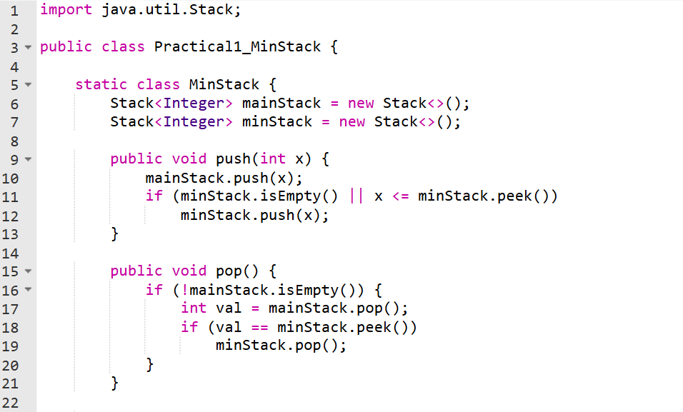
Code Implementation

Slide 9
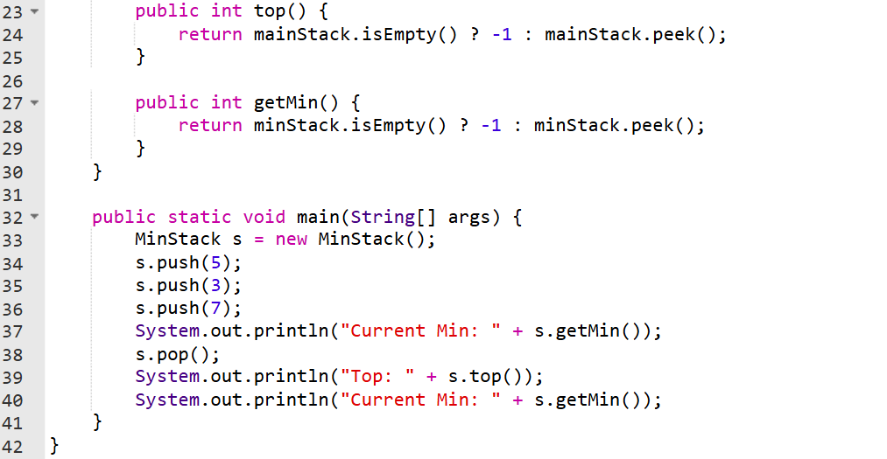

Slide 10
Output :
Current Min: 3
Top: 3
Current Min: 3

Slide 11
Time & Space Complexity
Operation | Time Complexity | Space Complexity | Why?
Push/Pop/Top/getMin | O(1) | O(N) | Constant access; Fixed arrays.
Display | O(N) | - | Linear print.

Slide 12
Summary
MinStack is an improved version of a normal stack that supports push(), pop(), top(), and getMin() operations — all in O(1) time.
It uses two stacks:
a. mainStack stores all elements.
b. minStack tracks the minimum value at each level.
On push(), if the new element ≤ current minimum, it’s also pushed into minStack.
On pop(), if the popped element equals the top of minStack, both are popped. getMin() simply returns the top of minStack, giving the minimum instantly.

Slide 13
Summary
This approach keeps all operations fast and efficient (O(1) time, O(n) space).
Advantage: No need to traverse the stack to find the minimum.
Use Case: Ideal for real-time applications where frequent min lookups are required.

Slide 14
Practice Questions:
1. Min Stack — LeetCode #155
🔗 https://leetcode.com/problems/min-stack/
Concept: Implement a stack that supports push(), pop(), top(), and getMin() in O(1).
Why Practice: Same as our class example — perfect for reinforcement.

Slide 15
Practice Questions:
2. Implement Queue using Stacks — LeetCode #232
🔗 https://leetcode.com/problems/implement-queue-using-stacks/
Concept: Implement a queue using one or two stacks.
Why Practice: Strengthens your stack understanding by reversing the logic.

Slide 16
Practice Questions:
3. Daily Temperatures — LeetCode #739
🔗 https://leetcode.com/problems/daily-temperatures/
Concept: Use a monotonic stack to find how many days you must wait until a warmer temperature occurs for each day.
Why Practice: Directly reinforces the Next Greater Element pattern using stacks, but applied to temperatures instead of numbers

Slide 17
Thanks

